Slide 1


Slide 2
Project
PRESENTATION

Slide 3

Online portal for tracking Seeds Record for Cultivation

Slide 4
Group Members Introduction
(BC230422757)

Slide 5
INTRODUCTION OF PROJECT
The "Online Portal for Tracking Seeds Record for Cultivation" is a web-based solution tailored to modernize the seed management practices within Pakistan's agricultural sector. Traditional paper-based systems are often inefficient, error-prone, and lack real-time accessibility. This portal addresses these issues by offering a centralized, digital platform where users can view, upload, and manage seed data with ease.
It supports diverse stakeholders including farmers, researchers, and agricultural firms by enabling them to track seed origins, assess performance in different climates, and make informed cultivation decisions. The system also facilitates seed transactions and provides secure access controls. With an intuitive interface accessible on both web and mobile devices, the platform ensures a seamless experience even for users with minimal technical knowledge.

Slide 6
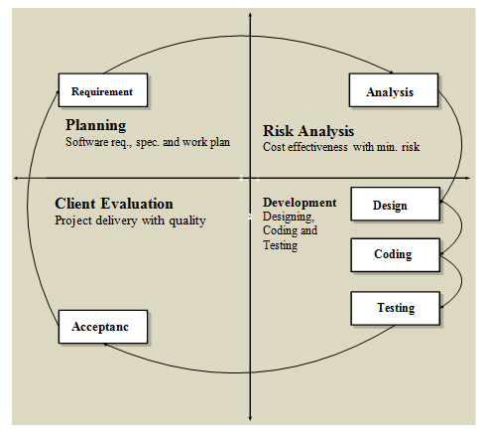
VU Process Model

Slide 7
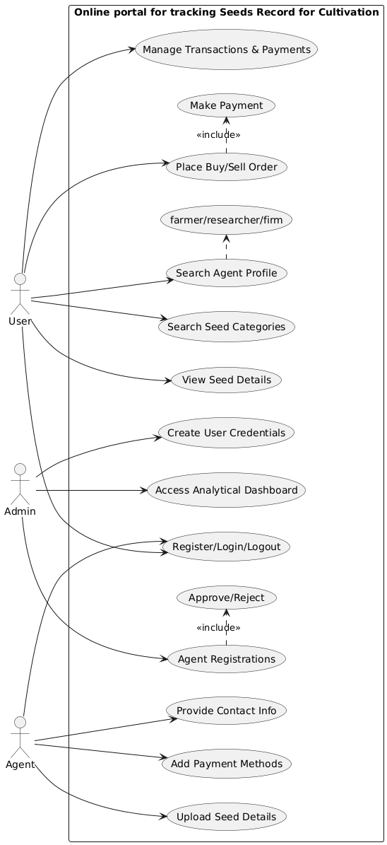
Use Case Diagram

Slide 8
Functional Requirements
End-User:
➢ The end-user visits the seeds web portal through domain name.
➢ The user searches the different categories of seeds.
➢ The user searches the required seeds with its full detail.
➢ The user can search the seed agent (farmer, Researcher or firm) profile
➢ The user can place the order to buy/sell the seeds
➢ The user can manage transaction and payment processing
Seed Agent:
➢ The seed agent will register to the portal first by providing the requisite information on form
➢ After Admin approval, the agent can login and upload the seed detail to the portal after
authentication
➢ Provide relevant contact information
➢ Provide online payment methods
Admin:
➢ The Admin will login to the system
➢ The Admin will grant approval to the registered farmers, Researchers, Agriculture centers
➢ The Admin will provide user name and password to the farmers, Researchers and Agriculture Centers or firms.
➢ The Admin will provide analytical dashboard for making better decisions

Slide 9
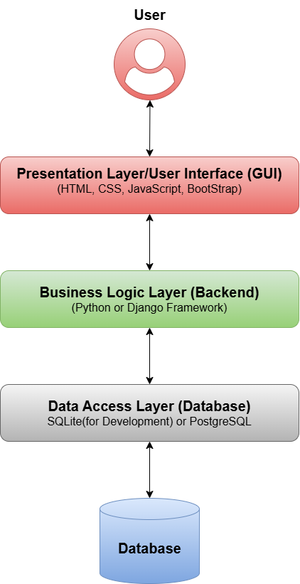
Architectural Design

Slide 10
Team Structure
Supervisor:
Haseeb Kamal
Student:
Sadia

Slide 11
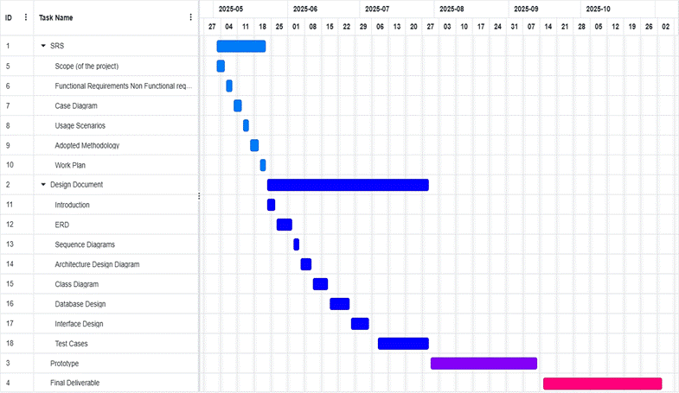
Project Schedule

Slide 12
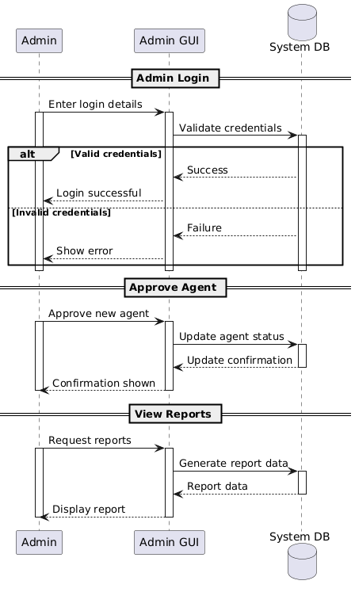
Sequence Diagrams
Admin:
.

Slide 13
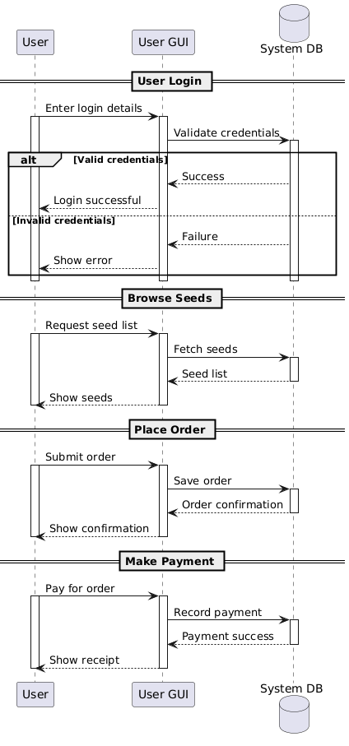
Sequence Diagrams
.

Slide 14
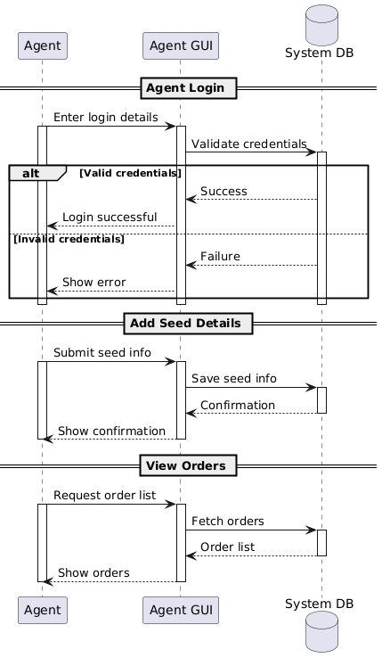
Sequence Diagrams
.

Slide 15
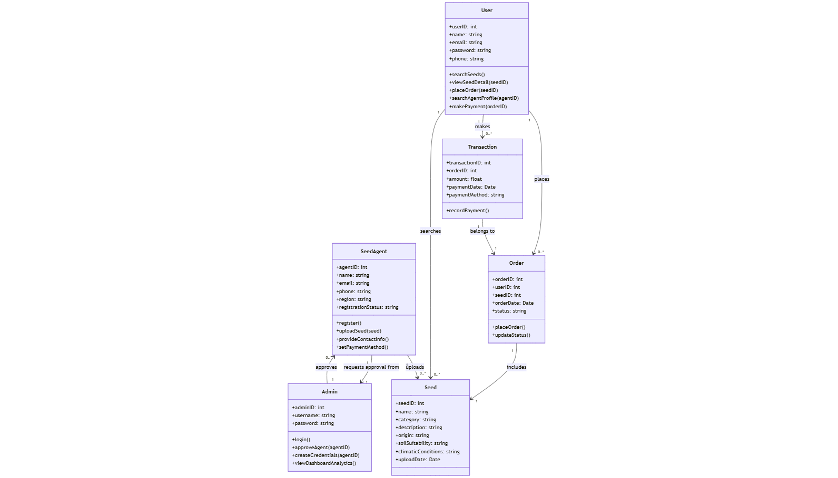
Class Diagram

Slide 16
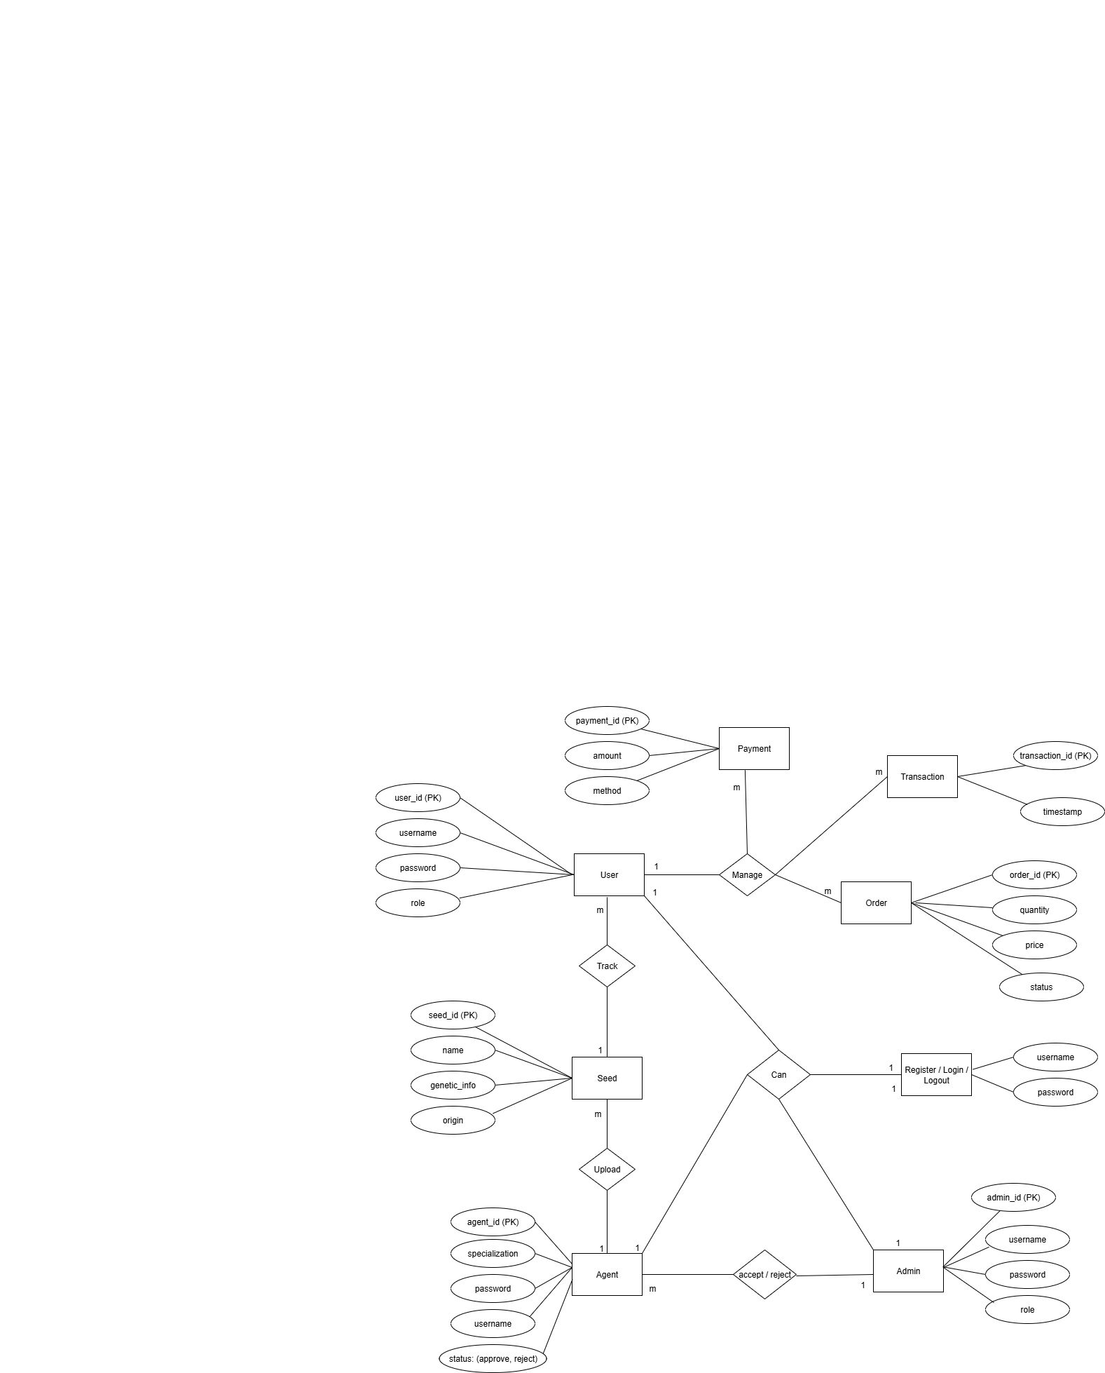
ERD

Slide 17
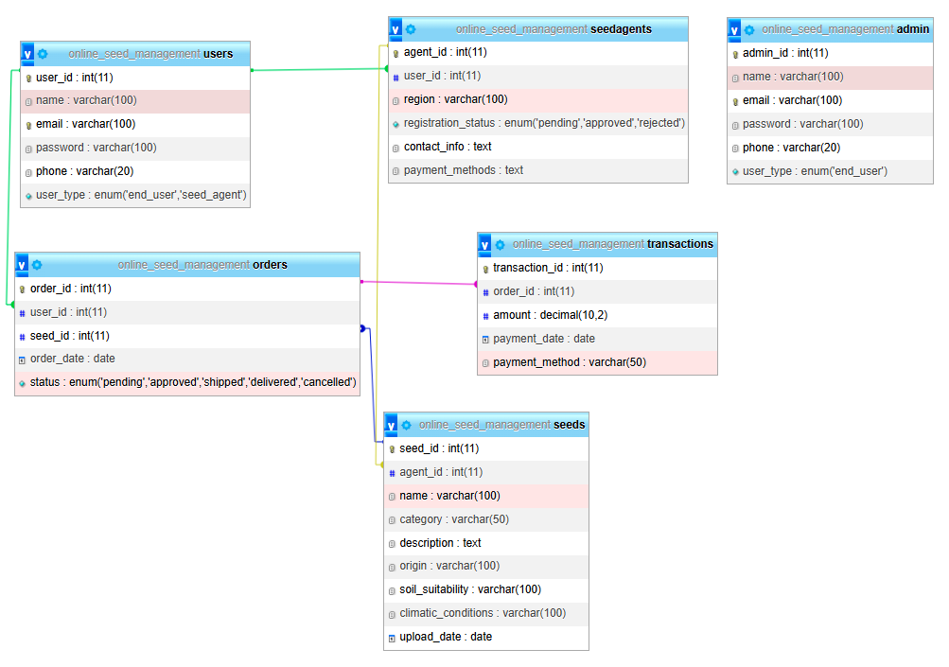
Database Diagram

Slide 18
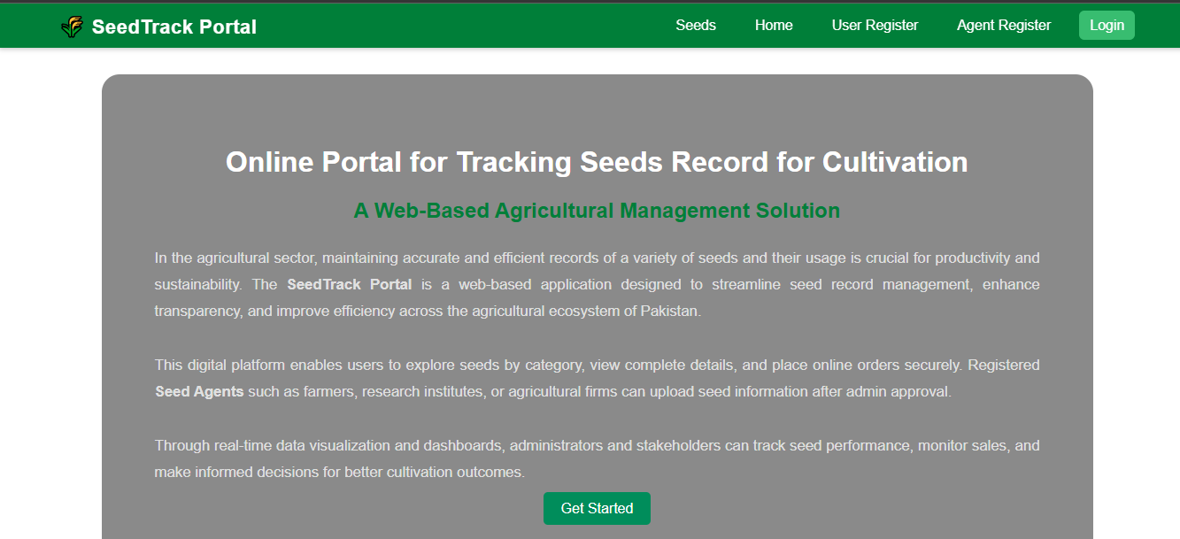
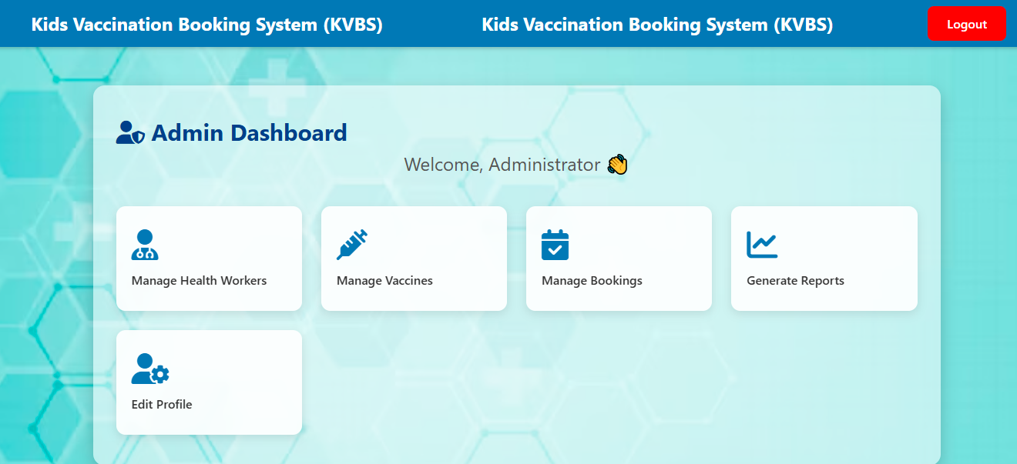
User Interfaces

Slide 19
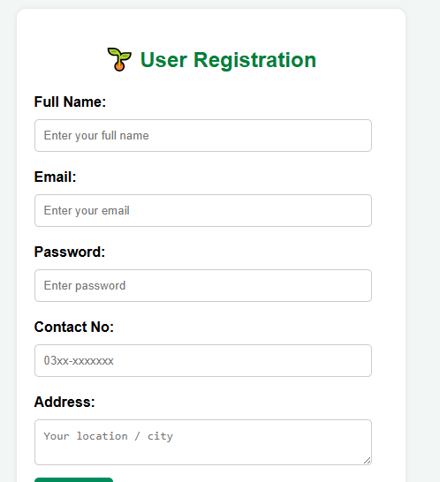
User Interfaces

Slide 20
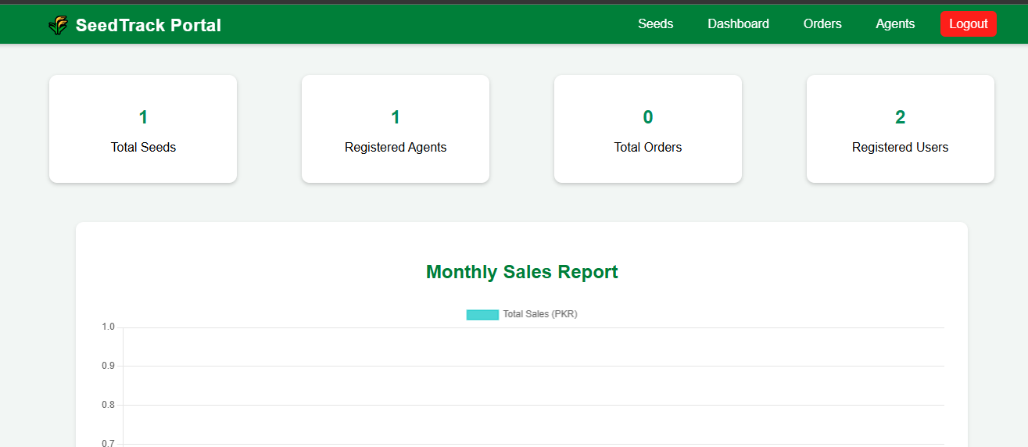
User Interfaces

Slide 21
Tools
Languages: HTML, CSS, PHP
Database Tool: MySql
Other Tools: Microsoft Office (Word, Visio, PowerPoint, MS Project) + VS Code

Slide 22
THANKS

